Slide 1
Course Title: Mathematical programming
(2-2-0-0)
Topic :
Solution to LPP
Graphical method
CO-1
Session - 2

Slide 2



AIM
To familiarize students with the concept of Graphical Method.
INSTRUCTIONAL OBJECTIVES
This session is designed to:
Illustrate in detail of Graphical method.
Demonstrate how to formulate the Graphical method.
LEARNING OUTCOMES
At the end of this unit, you should be able to:
Describe the ways to construct the Graphical method
Solve the formulation of linear programming problem with graphical method.

Slide 3
Topic delivery on Graphical Method
Any optimization problem with two variables can be solved
It is visual in nature
For solving the problems graphically, we need the following
Inequality Constraints
Objective Functions

Slide 4
Outlines of Graphical Method
The linear programming problems of two decision variables can be easily solved by graphical method.
The outlines of the graphical procedure as follows:
Step: 1 Identify the problem-the decision variables, the objective function and the restrictions.
Step: 2 set up the mathematical formulation of the problem.
Step: 3 consider each inequality –constraint as an equation
Step: 4 Plot each equation on the graph, as each one will geometrically represent a straight line.
Step: 5 Shade the feasible region. Every point on the line will satisfy the equation of the line. If the inequality constraint corresponding to that line is ‘≤’, then the region below the line lying in the first quadrant (due to non-negativity of variables) is shaded. For the inequality-constraint with ‘≥’ sign, the region above the line in the first quadrant is shaded. The points lying in the common region will satisfy all the constraints simultaneously. The common region thus obtained is called the feasible region.

Slide 5
Step: 6: Choose the convenient value of z(say-0) and plot the objective function line.
Step: 7 pull the objective function line until the extreme points of the feasible region. In the maximization case, this line will stop farthest from the origin and passing through at least one corner of the feasible region. In the minimization case, this line will stop nearest to the origin and passing through at least one corner of the feasible region.
Step: 8 Read the coordinates of the extreme point(s) selected in step6, and find the maximum or minimum value of z.

Slide 6
Problem
Using the graphical method, solve the following problem
Max Z=3x+2y
subject to the constraints
2x+y≤18,
2x+3y≤42,
3x+y≤24 and y≥0
Solution:
First, we draw the lines of all the given equations and shade the common region according to the signs.

Slide 7
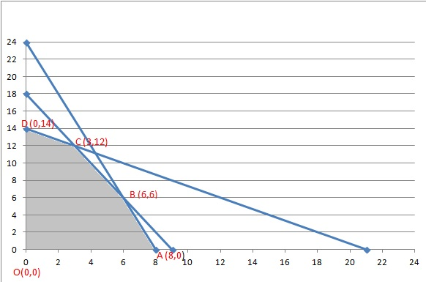

Slide 8
The feasible region is the intersection of the regions defined by the set of constraints and the coordinate axis (conditions of non-negativity of variables). This feasible region is represented by the O-A-B-C-D-O
As a feasible region exists, extreme values (or polygon vertices) are calculated. These vertices are the point’s candidate as optimal solutions. In the example, these points are O, A, B, C, and D, as shown in the figure.

Slide 9
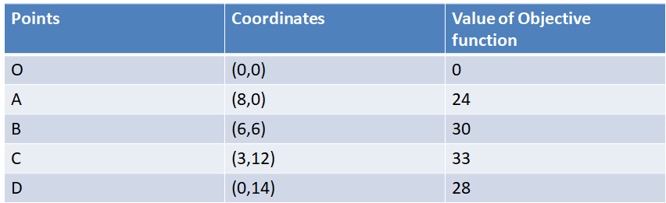
Finally, the objective function is evaluated in each of these points (results are shown in the tableau below). Since C-point provides the greatest value to the Z-function and the objective is to maximize, this point is the optimal solution: Z = 33 with x = 3 and y = 12

Slide 10
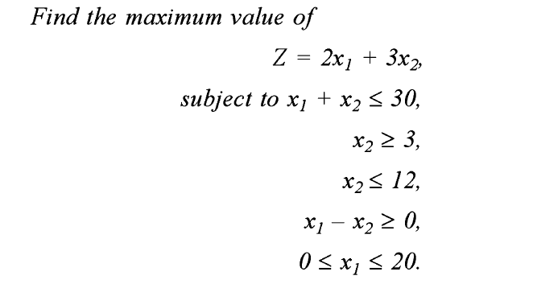
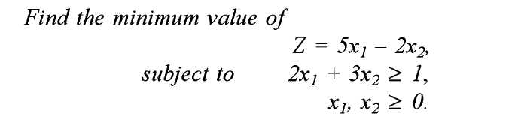
Example Problems

Slide 11
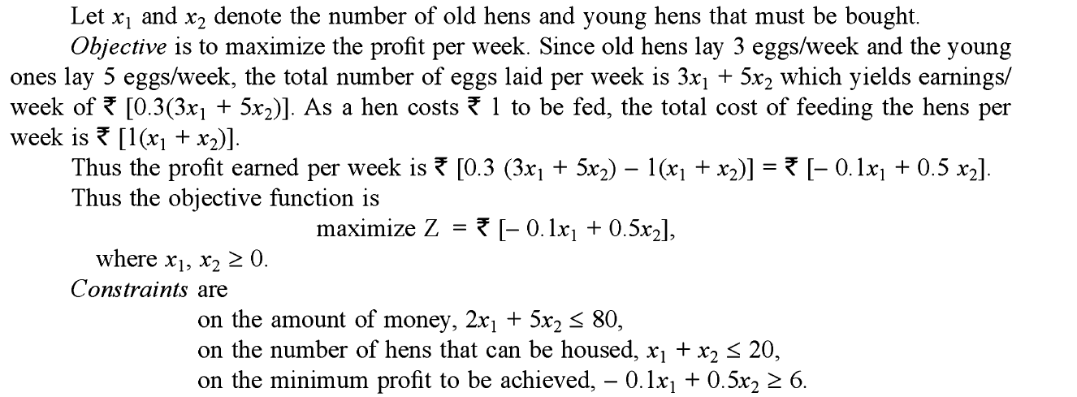
Formulation of an LPP and finding optimal solution using Graphical method problem

Slide 12
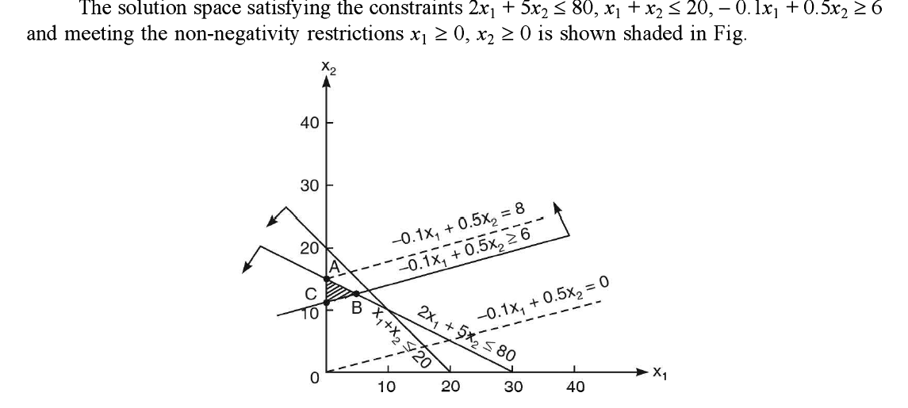

Slide 13
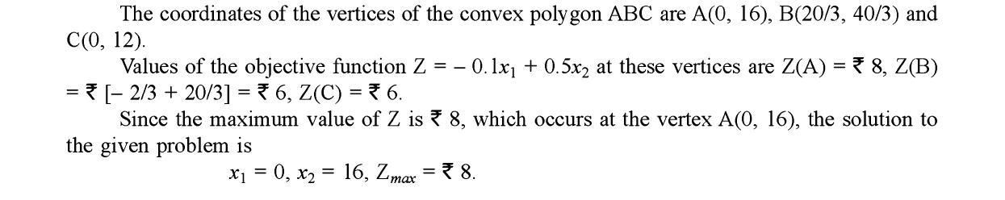

Slide 14
References
Textbook:
1. Introduction to Mathematical Programming by Russell C. Walker, published by Pearson Custom Publishing, 2006
2. S. P. Bradley, A. C. Hax, and T. L. Magnanti, Applied Mathematical Programming, Addison-Wesley Publishing Company, 1977
3. Lenstra, Rinnooy Kan, & Schrijver (eds.), History of Mathematical Programming: A Collection of Personal Reminiscences, Elsevier, 1991.
Web Resources:
https://nptel.ac.in/courses/110105096
https://www.coursera.org/learn/operations-research-modeling
https://www.semanticscholar.org/paper/Applied-Mathematical-Programming-Bradley-Hax/8a4ee083b23505df221410e6a2b41fc56fa250a6

Slide 15

THANK YOU
Team – Mathematical Progrmming

